Slide 1
Offensive Language Detection
Nick Lu (tlu32) Keyi Ding (kding5) Ting Li (tli79)
Applications, Text data

Slide 2
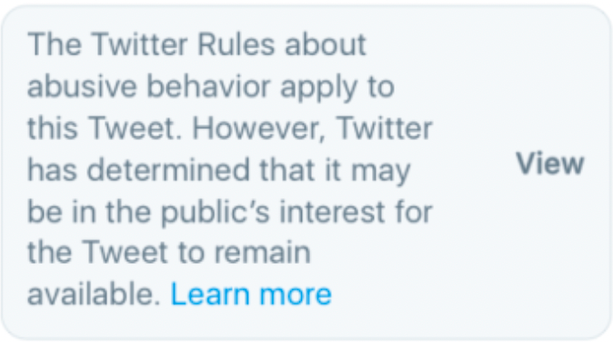
Problem Definition
Automate hate speech & offensive language detection
Sentences from Twitter with labels on whether people think the sentences are hateful or offensive
Classification task based on supervised learning
RNN & LSTM
Notes:
https://colah.github.io/posts/2015-08-Understanding-LSTMs/
What problem were you trying to solve or understand?
What kind of data did you work with?
How does this fit into the concepts of the course?
Was this supervised or unsupervised learning?
Regression or classification?
etc.

Slide 3
Why is this an interesting problem?
Hate speeches are common on social media, and it would be easier for such speeches to be regulated if some program can automatically detect them.
The problem is similar to the language recognition in hw3 lab in that we take a natural language input as a sequence, and train a model to predict some labels associated with such input sequence.
Hate speech is sometimes hard to detect because it really depends on the context the language is used.
It is hard to get unbiased, correctly labeled training data.

Slide 4
Dataset:
24773 examples, 3 labels, and 384 features.
Unnamed:0 | count | hate_speech | offensive_langague | neither | class | tweet
0 | 3 | 0 | 0 | 3 | 2 | !!! RT @mayasolovely: As a woman you shouldn't complain about cleaning up your house. &amp; as a man you should always take the trash out...
1 | 3 | 0 | 3 | 0 | 1 | !!!!! RT @mleew17: boy dats cold...tyga dwn bad for cuffin dat hoe in the 1st place!!
Labeled Data, Hate Speech and Offensive Language (Davidson et al., 2017)
Notes:
What does your data look like? Show an example or two.
How many examples, labels, features, etc.?
Word embedding we chose word2vec catalog they use 384 as their feature size
What did you do to pre-process your data? Why?

Slide 5
Dataset: Regex preprocess
!!! RT @mayasolovely: As a woman you shouldn't complain about cleaning up your house. &amp; as a man you should always take the trash out...
Username | "@.*:" and "@.* "
Retweet | !*\sRT
https | r'https?://[^ ]+'
html bad encoding | "&.*;"
Recurring letter | '([A-Za-z])\1{2,}' to '\1'
Recurring punctuation | '(\W)\1{1,}' to '\1'
Hashtag | '#.* '
Non-alphanumeric | [^A-Za-z0-9]+

Slide 6
Dataset
Unnamed:0 | count | hate_speech | offensive_langague | neither | class | tweet
0 | 3 | 0 | 0 | 3 | 2 | as a woman you shouldnt complain about cleaning up your house as a man you should always take the trash out
1 | 3 | 0 | 3 | 0 | 1 | boy dats coldtyga dwn bad for cuffin dat hoe in the 1st place
Processed Data

Slide 7
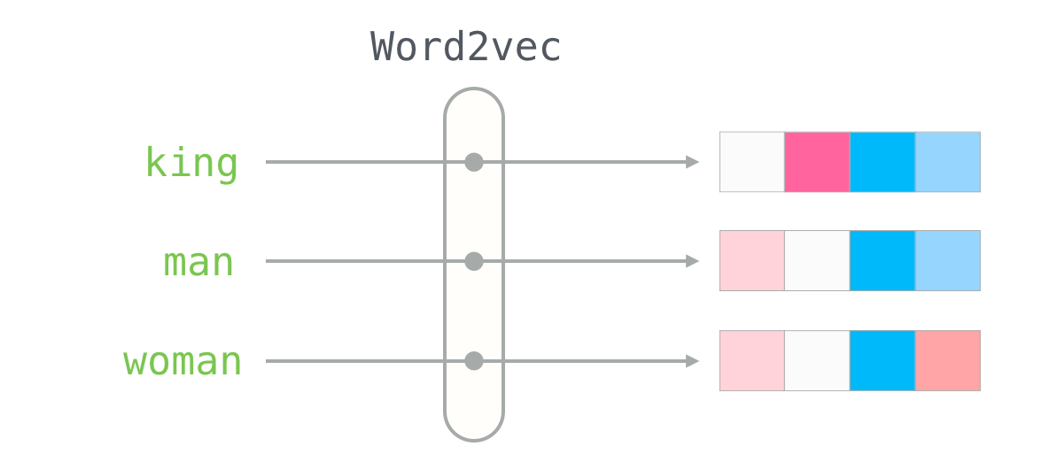

Methods
Notes:
What methods did you choose? Why did you choose them?
Word2Vec+LSTM. Word2Vec converts each word in the sentence into embedding in which words with similar meanings have shorter distance between each other. To make it a sentence embedding, we concatinate the word embeddings in them to form a sentence embedding.
LSTM captures the natural ordering of sentence, no vanishing gradients or long-term dependence issue.
How did you train these methods, and how did you evaluate them? Why?
CrossEntropyLoss + Adam optimizer
Compute validation loss in each epoch
To minimized the loss, we incorporate a adaptive learning rate method, which evaluates whether the current validation loss is not improving over a couple a epochs
Balanced training set: the number of offensive and non-offensive sentences are 10:1 in the training set so we wrote a random sampling function that assigns offensive samples lower weights and non-offensive samples higher weights so that the training set after processing will be balanced

Slide 8
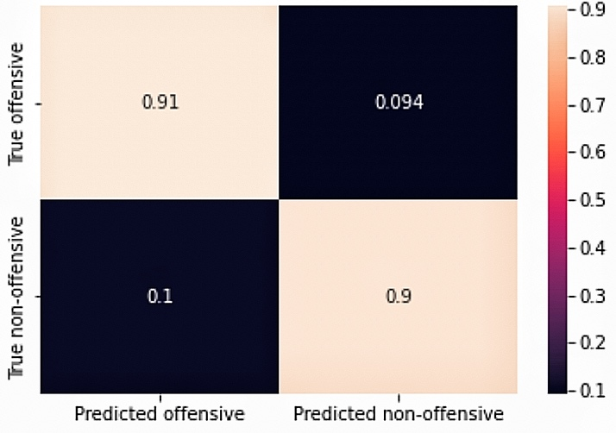
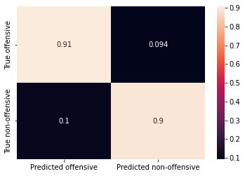
Results
Accuracy=0.905 F1-score=0.943
Precision=0.982 Recall=0.906
Notes:
High precision: The sentences that our model classifies as "offensive" are very likely to be indeed offensive
High recall: among all offensive sentences, our model can correctly classify most of them

Slide 9
Deliverables
We have preprocessed the training data, trained the model, and generated a list of improper words.
Measuring hate level and categorizing hateful speeches are more difficult because we do not have a proper training data.

Slide 10
What we’ve learned
RNN, LSTM, word embedding 📝
Longer sentences, better performance 😲
More balanced dataset, containing more “neither” entries
Softmax performs worse than ReLU, given a multi-class classification setting
Notes:
What concepts from lecture/breakout were most relevant to your project?
What aspects of your project did you find most surprising?
What would you do differently if you were going to start from the beginning?
What questions do you still have?

Slide 11
References
Davidson, T., Warmsley, D., Macy, M., & Weber, I. (2017). Automated hate speech detection and the problem of offensive language. Proceedings of the International AAAI Conference on Web and Social Media, 11(1), 512–515. https://doi.org/10.1609/icwsm.v11i1.14955
Understanding LSTM networks. Understanding LSTM Networks -- colah's blog. (2015, August 27). Retrieved December 9, 2022, from https://colah.github.io/posts/2015-08-Understanding-LSTMs/

